Slide 1
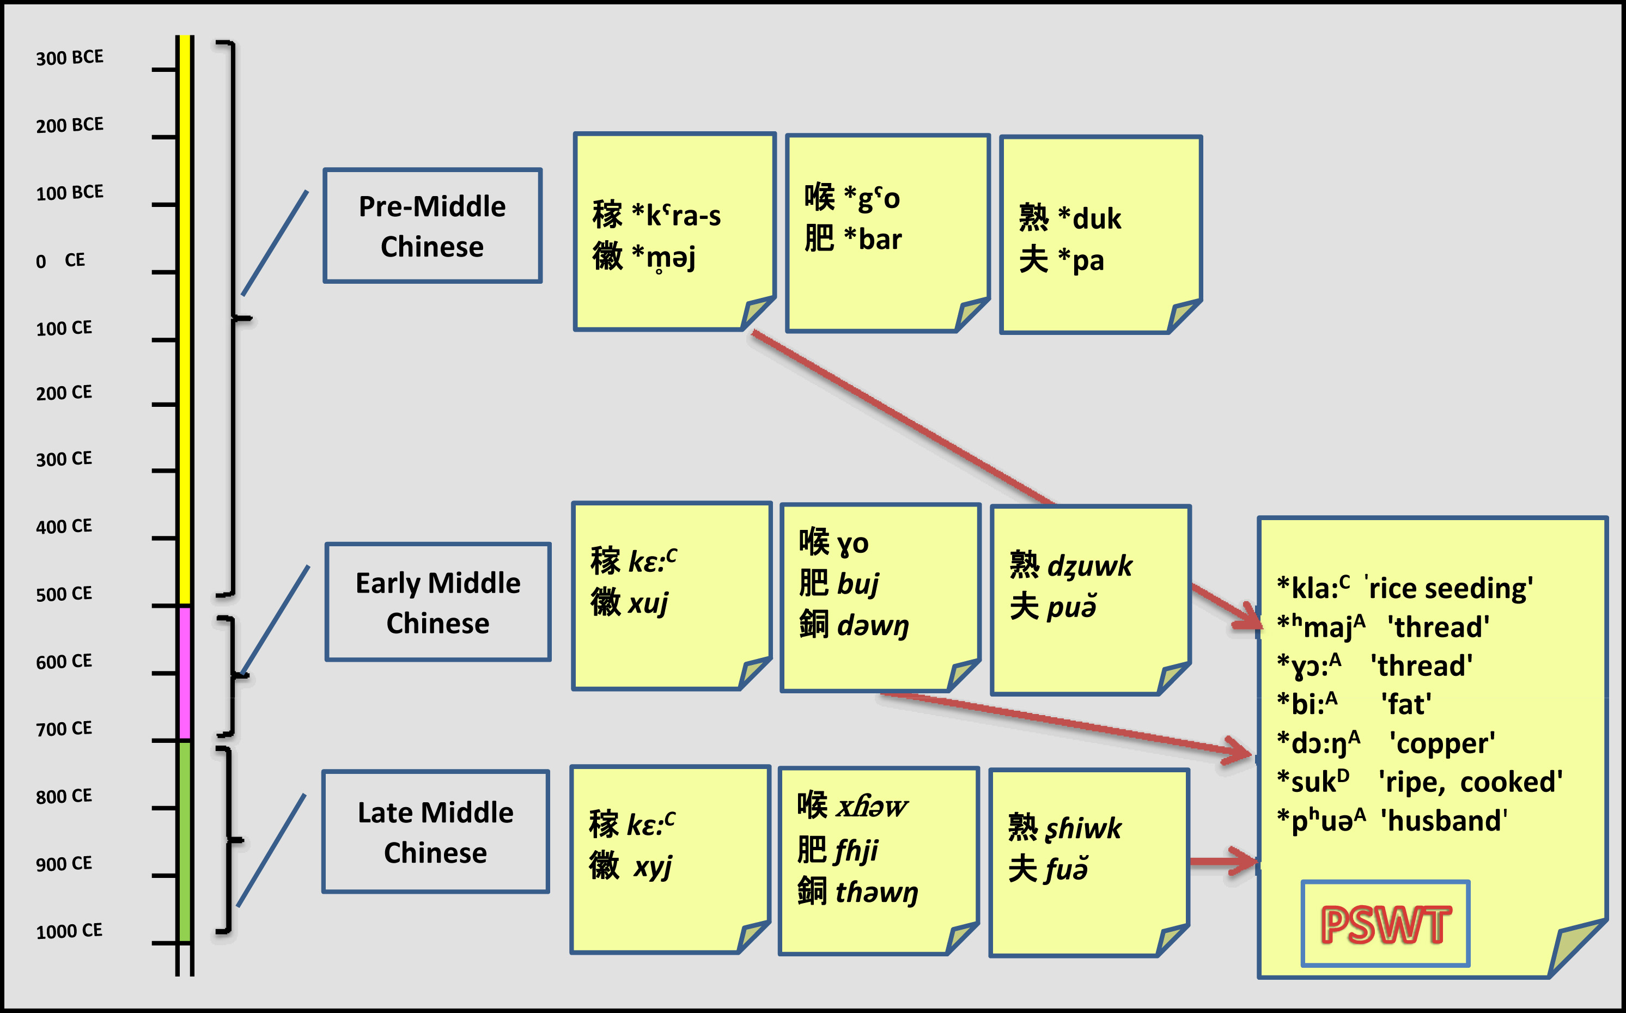
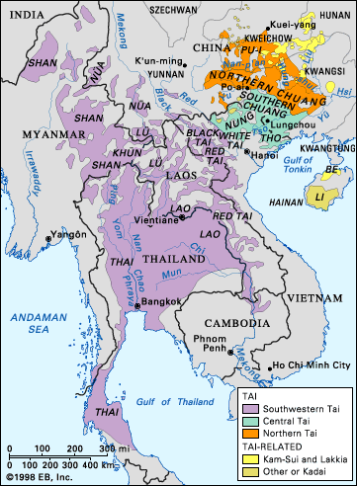
A speculation on the dating of Southwestern Tai migration
Pittayawat Pittayaporn
Department of Linguistics
Chulalongkorn University (Pittayawat.P@chula.ac.th)
1. Introduction
4. Early Middle Chinese loanwords
Any linguistic evidence on the dating of SWT migration into Southeast Asia?
Etyma showing *ɣ- for OC *g-:
‘throat’ *ɣɔː ^{A} < 喉hóu (EMC ɣəw, OC *gˤo)
‘shin’ *ɣɛːŋ^{B} < 脛jìng (EMC ɣɛjŋ, OC *m-kʰˤeŋ-s)
Etyma showing voiced onsets followed by post-OC rimes:
‘fat’ *bi^{B} < 肥 féi (EMC buj, OC *bər)
‘to defeat’ *bɛː^{C} < 敗 bài (EMC bɛ:j^{C}, OC *N-pˤrat-s)
‘name’ *ɟɯː^{B} < 字 zì (EMC dzɨ^{C}, OC *mə-dzə-s)
Etyma showing post-OC voiced stops:
‘elephant’ < 象 xiàng (EMC zɨaŋ^{B}, OC *s-daŋʔ)
‘way’ *daːŋ^{A}< 塘 táng (EMC daŋ)
‘copper’ *dɔːŋ^{A} < 銅 tóng (EMC dəwŋ)
Southwestern Tai (SWT) is by far the most widespread subgroup of the Tai language family. The ancestor of Tai languages most likely originated in southern Guangxi, China, but SWT has replaced indigenous Mon-Khmer languages in a large area of Southeast Asia. O’Connor (1995) suggests that the Tai migration into Southeast Asia started in the first millennium A.D. Diller (2000) similarly suggests that the southwest-ward migration of Tai speakers started in the 10th century.
Figure1 Distribution of Tai languages
in Southeast Asia (Encyclopedia Britannica, Inc.)
5. Late Middle Chinese loanwords
Etyma showing aspirated onsets for EMC voiced onsets:
‘bean’ *tʰuə^{B} < 豆dòu (LMC tɦəw^{C}, EMC dəw^{C})
‘young male animal’ *tʰɤk^{D} < 特tè (LMC tɦək , EMC dək)
‘eggplant’ *kʰɯə^{A} < 茄qié (LMC kɦia , EMC gɨa)
‘to lie athwart’ *kʰwaːŋ^{A} < 橫héng (LMC xɦwa:jŋ, EMC ɣwaɨjŋ)
‘enemy’ *sɤk^{D} < 賊 zéi (LMC tsɦəăk , EMC dzək)
‘ten’ *sip^{D} < 十shí (LMC ʂɦip , EMC dʑip)
‘ripe, cooked’ *suk^{D} < 熟shú (LMC ʂɦiwk, EMC dʑuwk)
Etyma showing *pʰ- or *v- for LMC labiolabial onsets:
‘husband’ *pʰuə^{A} < 夫fū (LMC fuə̆, EMC puə̆)
‘float’ *vuː^{A} < 浮fú (LMC fɦuw, EMC buw)
j
2.Data &Methods
Figure 2: Layers of Chinese loanwords in PSWT
Lexical data from 28 languages from Gedney’s Comparative Tai Source Book (Hudak 2008), the author’s field note and other published wordlists and dictionaries were systematically compared. Chinese loanwords were identified from among reconstructible etyma of Proto-SWT, the hypothetical ancestral language of SWT (Pittayaporn 2009). These loanwords were classified according to the stage of Chinese during which they were borrowed. The date of the latest layer of Chinese loanwords was as evidence for the SWT migration into SEA.
7.References
Diller, Anthony. 2000. The Tai language family and the Comparative Method. In S. Burusphat (Ed.), Proceedings : the International Conference on Tai Studies, July 29-31, 1998. (pp. 1-32). Nakhon Pathom: Institute of Language and Culture for Rural Development, Mahidol University.
O’Connor, Richard. 1995. Agricultural change and ethnic succession in Southeast Asian states: A case for regional anthropology. Journal of Asian Studies 54.4: 968-96.
Pittayaporn, Pittayawat. 2009. Proto-Southwestern Tai Revised: A new reconstruction. Journal of the Southeast Asian Linguistics Society, 2: 212-144.
Pulleyblank, Edwin G. 1984. Middle Chinese: A study in historical phonology. Vancouver: University of British Columbia Press.
Pulleyblank, Edwin G. 1991. Lexicon of reconstructed pronunciation in Early Middle Chinese, Late Middle Chinese, and Early Middle Chinese. Vancouver: University of British Columbia Press.
Sagart, Laurent, and William, Baxter. 2011. Baxter-Sagart Old Chinese reconstruction, version of 20 February 2011. Online at http://crlao.ehess.fr/document.php?id=1217. Accessed September 13, 2011.
Ting Pang-hsin. 1993. “Periodization of Chinese phonology.” Paper presented at the Second International Conference on Chinese Linguistics (ICCL-2), 23-25 June 1993, Paris, France.
Witthayasakphan, Somphong. 2001. Prawattisat Thai Yai [Shan history]. Bangkok: Tai Social and Cultural History Project.
3. Pre-Middle Chinese loanwords
Etyma showing onset clusters:
‘rice seedling’ *klaː^{C} < 稼jià (LH kaː^{C}, OC *kˤra-s)
‘indigo’ *graːm^{A} < 藍lán (LH lɑm, OC *N-k.rˤam)
‘lazy’ *graːn^{C} < 懶lǎn (OC *N-kə.rˤanʔ)
Etyma showing voiceless sonorants:
‘fog’ *ʰmɔːk^{C} < 懶mù (LH muo^{C}, OC *kə.mok-s)
‘thread’ *ʰmaj^{A} <徽huī (LH hui, OC *m̥əj)
‘six’ *ʰrok^{D} < 六liù (LH liuk, OC *k.ruk)
‘steel’ *ʰlek^{D} < 鐵 tiě (LH thet, OC *l̥ˤik)
6. Speculated date of SWT migration
The layering of Chinese loanwords indicates that the SWT migration must have started sometime in the 8-9th century CE. LMC loanwords in PSWT indicate that it must have occurred after the EMC period around the 5th-7th centuries (Pulleyblank 1984; 1991; Ting 1993). However, in the 10th the Shan were already established in the Dehong area, Yunnan (Witthayasakphan 2001). Linguistic evidence thus lends support to earlier speculations that the Tai started to migrate into Southeast Asia in the latter half of the 1st millennium.
Acknowledgment:
Supported by the Center of Excellence Program in Language, Linguistics, and Literature (Chulalongkorn Centenary Academic Development Project)

